Slide 1
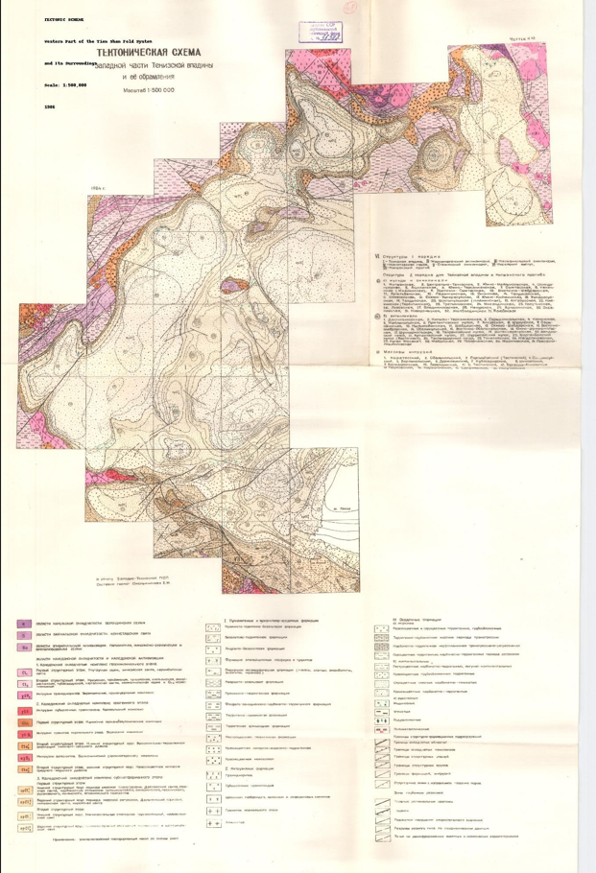
VI. Structures of the First Order
I – Tien Shan fold system, II – Karatau anticlinorium, III – Kyzylkum synclinorium, IV – Konratbashi trough, V – Stepnyak synclinorium, VI – Milyan uplift, VII – Milyan trough
Structures of the Second Order for the Tien Shan Depression and Milyan Basin
a) Folds and Synclines
Mikhailovsk, 2. Central Tien Shan, 3. South-Malmysh, 4. Shor-Tau, 5. Aksu-Dzhabagly, 6. South-Terskey, 7. East-Kassansky (Kumbel), 8. East-Santa-Shor, 9. East-Shabdar, 10. Northeast-Sabdar, 11. Northeast-Kassansky, 12. Karakuldzha, 13. Sarydzhas, 14. North-Terskey, 15. Toktogul, 16. Chon-Kemin, 17. Taldykorgan, 18. Shoptykul (Filimonov), 19. Agtash, 20. Knyazev, 21. Uzin, 22. Uzak, 23. Naryn, 24. Kochkor, 25. Dzhety-Oguz, 26. Chatyr-Kul, 27. Ala-Buka, 28. Chandalash, 29. Novodzhereliev, 30. Nolbaldinsky, 31. Zhanibek
b) Anticlines
Kichi-Terskey, 2. Sarydzhaz-Terskey, 3. Nemansky, 4. Psekhako, 5. Mazar, 6. Karadzhorgo, 7. Aktash, 8. Kyzyl-Agash, 9. Uch-Koshkon, 10. South-Bulun, 11. North-Bulun, 12. Karatau, 13. Yangiabad, 14. Karatal, 15. Yangi-Kurama, 16. Aksu, 17. Kyzyl-Dzhar, 18. Orto-Tokoy, 19. Osh, 20. Namangan, 21. Ferghana, 22. Kokand, 23. Tashkent, 24. Chimkent, 25. Dzhambul, 26. Alma-Ata, 27. Przhevalsk, 28. Sarybulak, 29. Ilyinsk, 30. Kazakh, 31. Levoberezhny
Mass Intrusions
Karatas, 2. Obvalovsky, 3. Sarybulak (Tastyk), 4. Sary-Choku, 5. Borsky, 6. Dzhergalan, 7. Kyzyl-Sary, 8. Uch-Terek, 9. Kubasar, 10. Dzhagalak, 11. South-Aksu

Slide 2
Geological Regions
K - Karelia Folded Area, Belomorian Series
B - Baikal Folded Area, Konektaskaya Suite
Ba - Zones of Embasement Activation, Boundary, Novokiev-Burunian, and Bug-Dniester Series
Tectonic Formations
I. Volcanogenic and Volcano-Sedimentary Formations
Clastic-Terrigenous-Basalt Formations
Basalt-Terrigenous Formations
Andesite-Basalt Formations
Epimetamorphic Porphyrites and Trachytes
Metamorphosed Formations (Gneiss, Schist, Amphibolite)
Quartz-Sandstone Formations
Tuffaceous-Terrigenous Formations
III. Sedimentary Formations
a) Marine
Red-colored and gray-colored terrigenous, deep-water deposits
Terrigenous-carbonate deposits of the transgression period
Carbonate-terrigenous deposits of incomplete transgressive-regressive cycles
Sulfur-rich terrigenous, carbonate-terrigenous deposits of the regression period
b) Continental
Nonmarine carbonate-terrigenous, lagoon-continental deposits
Red-colored deep-sea terrigenous deposits
Gray-green carbonate-argillaceous deposits
Red-colored carbonate-terrigenous deposits
Caledonian Folded Areas and Paleozoic Activation
Caledonian Folded Stage:
Early Structural Stage: Nuomansk, Tavasinsk, Tallebayinsk, Elyanchinsk-Antisk, Kuzbasorinsk, Karakolsk Suites, and Ognemar Groups.
Second Structural Stage: Nauminsk Plutonic Complex
Magmatic Formations: Volcanic-Terrigenous Deposits
Hercynian Folded Complex (Orogenic Stage)
Intrusions of Subalkaline Granite, Granodiorite, Adamellite Complex
Late Structural Stage:
Middle Paleozoic Volcanic-Terrigenous Deposits
Upper Structural Stage: Middle Carboniferous Clastic Formations
c) Evaporite
Copper Bearing
Argillaceous
Radiolarite
Polymetallic
Boundaries of Structural-Formational Units
Boundaries of fold areas
Boundaries of folded complexes
Boundaries of structural "floors"
Boundaries of structural blocks
Boundaries of formations and intrusions
Structural Lines
Structural lines with the direction of rock dip
Deep Fault Zones
Zones of deep-seated faults
Boundaries of regional uplifts
Other Features
Uplifts
Disruptions of constructional significance
Fractures of various types based on geophysical data
Note: Does not differentiate between biohermal and non-biohermal reef formations.
II. Intrusive Formations
Granodiorites
Subalkaline Granitoids
Gabbro-Norite, Shoshonites, Nepheline Syenites

